Slide 1
Sorting & Searching Technique

Slide 2
Introduction to Sorting
Sorting is nothing but arranging the data in ascending or descending order. The term sorting came when humans realized the importance of searching quickly.
There are so many things into the real life that need to search for, like a particular record in database, roll numbers in merit list, a particular telephone number in telephone directory, a particular page in a book etc. All this would have been a mess if the data was kept unordered and unsorted, but fortunately the concept of sorting came into existence, making it easier for everyone to arrange data in an order, hence making it easier to search.
Sorting arranges data in a sequence which makes searching easier.

Slide 3
Sorting Efficiency:
The two main criteria's to judge which algorithm is better than the other have been:
Time taken to sort the given data.
Memory Space required to do so.
Different Sorting Algorithms:
There are many different techniques available for sorting, differentiated by their efficiency and space requirements. Following are some sorting techniques which we will be covering in next few tutorials.
Bubble Sort , Insertion Sort,
Selection Sort, Quick Sort,
Merge Sort, Heap Sort

Slide 4
An array using Bubble sort technique

Slide 5
Bubble Sort Algorithm
Bubble Sort is a simple algorithm which is used to sort a given set of n elements provided in form of an array with n number of elements. Bubble Sort compares all the element one by one and sort them based on their values.
If the given array has to be sorted in ascending order, then bubble sort will start by comparing the first element of the array with the second element, if the first element is greater than the second element, it will swap both the elements, and then move on to compare the second and the third element, and so on.
If we have total n elements, then we need to repeat this process for n-1 times.
It is known as bubble sort, because with every complete iteration the largest element in the given array, bubbles up towards the last place or the highest index, just like a water bubble rises up to the water surface.
Sorting takes place by stepping through all the elements one-by-one and comparing it with the adjacent element and swapping them if required.

Slide 6
Implementing Bubble Sort Algorithm
Following are the steps involved in bubble sort(for sorting a given array in ascending order):
Starting with the first element(index = 0), compare the current element with the next element of the array.
If the current element is greater than the next element of the array, swap them.
If the current element is less than the next element, move to the next element. Repeat Step 1.
Let's consider an array with values {5, 1, 6, 2, 4, 3}
Pictorial representation of how bubble sort will sort the given array:

Slide 7
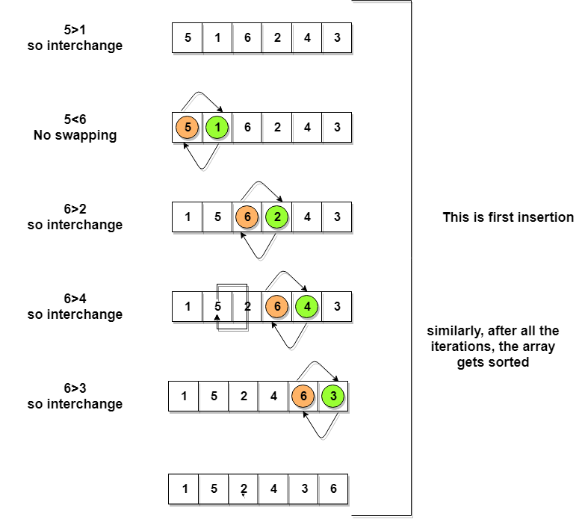

Slide 8
Algorithm
Assume list is an array of n elements. We further assume that swap function swaps the values of the given array elements.
begin BubbleSort(list)
for all elements of list
if list[i] > list[i+1]
swap(list[i], list[i+1])
end if
end for
return list
end BubbleSort

Slide 9
#include <stdio.h>
#define MAXSIZE 10
void main()
{
int array[MAXSIZE];
int i, j, num, temp;
printf("Enter the value of num \n");
scanf("%d", &num);
printf("Enter the elements one by one \n");
for (i = 0; i <num; i++)
{
scanf("%d", &array[i]);
}

Slide 10
printf("Input array is \n");
for (i = 0; i <num; i++)
{
printf("%d\n", array[i]);
}
/* Bubble sorting begins */
for (i = 0; i <num; i++)
{
for (j = 0; j < (num - i - 1); j++)
{
if (array[j] > array[j + 1])
{
temp = array[j];
array[j] = array[j + 1];
array[j + 1] = temp;
} } }

Slide 11
printf("Sorted array is...\n");
for (i = 0; i <num; i++)
{
printf("%d\n", array[i]);
}
}

Slide 12
Algorithm using Selection Sort Technique

Slide 13
Selection sort is one of the simplest sorting algorithms. It is similar to the hand picking where take the smallest element and put it in the first position and the second smallest at the second position and so on. It is also similar. First check for smallest element in the array and swap it with the first element of the array. Again, check for the smallest number in a subarray excluding the first element of the array as it is where it should be (at the first position) and put it in the second position of the array. And then continue repeating this process until the array gets sorted.
The time complexity of selection sort is (O(n²)).

Slide 14
Following steps to perform selection sort:
Start from the first element in the array and search for the smallest element in the array.
Swap the first element with the smallest element of the array.
Take a subarray (excluding the first element of the array as it is at its place) and search for the smallest number in the subarray (second smallest number of the entire array) and swap it with the first element of the array (second element of the entire array).
Repeat the steps 2 and 3 with new subarrays until the array gets sorted.

Slide 15
Algorithm:
Step 1 − Set MIN to location 0
Step 2 − Search the minimum element in the list
Step 3 − Swap with value at location MIN
Step 4 − Increment MIN to point to next element
Step 5 − Repeat until list is sorted
// Sort an arr[] of size n Selection_Sort() Loop from i = 1 to n-1. ……a) Pick element a[i] and select it into sorted sequence a[0…i-1] or a[min]

Slide 16
Initial array
16 | 19 | 11 | 15 | 10 | 12 | 14
First iteration
16 | 19 | 11 | 15 | 10 | 12 | 14
10 | 19 | 11 | 15 | 16 | 12 | 14
Second iteration
10 | 19 | 11 | 15 | 16 | 12 | 14
10 | 11 | 19 | 15 | 16 | 12 | 14
Third iteration
10 | 11 | 12 | 15 | 16 | 19 | 14
10 | 11 | 12 | 14 | 16 | 19 | 15

Slide 17
Fourth iteration
10 | 11 | 12 | 15 | 16 | 19 | 14
10 | 11 | 12 | 14 | 16 | 19 | 15
Fifth iteration
10 | 11 | 12 | 14 | 16 | 19 | 15
10 | 11 | 12 | 14 | 15 | 19 | 16
Sixth iteration
10 | 11 | 12 | 14 | 15 | 19 | 16
10 | 11 | 12 | 14 | 15 | 16 | 19
Final iteration
10 | 11 | 12 | 14 | 15 | 16 | 19

Slide 18
#include <stdio.h>
void selection_sort();
int a[30], n;
void main()
{
int i;
printf("\nEnter size of an array: ");
scanf("%d", &n);
printf("\nEnter elements of an array:\n");
for(i=0; i<n; i++)
scanf("%d", &a[i]);
selection_sort();
printf("\n\nAfter sorting:\n");
for(i=0; i<n; i++)
printf("\n%d", a[i]);

Slide 19
getch();
}}
void selection_sort()
{
int i, j, min, temp;
for (i=0; i<n; i++)
{
min = i;
for (j=i+1; j<n; j++)
{
if (a[j] < a[min])
min = j; }
temp = a[i];
a[i] = a[min];
a[min] = temp;
} }

Slide 20
Algorithm using Insertion Sort Technique

Slide 21
This is an in-place comparison-based sorting algorithm. Here, a sub-list is maintained which is always sorted. For example, the lower part of an array is maintained to be sorted. An element which is to be inserted in this sorted sub-list, has to find its appropriate place and then it has to be inserted there. Hence the name, insertion sort.
The array is searched sequentially and unsorted items are moved and inserted into the sorted sub-list (in the same array). This algorithm is not suitable for large data sets as its average and worst case complexity are of Ο(n²), where n is the number of items.

Slide 22
Algorithm:
Step 1 − If it is the first element, it is already sorted. return 1;
Step 2 − Pick next element
Step 3 − Compare with all elements in the sorted sub-list
Step 4 − Shift all the elements in the sorted sub-list that is greater than the value to be sorted
Step 5 − Insert the value
Step 6 − Repeat until list is sorted
Algorithm: // Sort an arr[] of size n insertionSort(arr, n) Loop from i = 1 to n-1. ……a) Pick element arr[i] and insert it into sorted sequence arr[0…i-1]
Next Insertion Sort Works:

Slide 23





We take an unsorted array for our example.
Insertion sort compares the first two elements.
It finds that both 14 and 33 are already in ascending order. For now, 14 is in sorted sub-list.
Insertion sort moves ahead and compares 33 with 27.
And finds that 33 is not in the correct position.

Slide 24



It swaps 33 with 27. It also checks with all the elements of sorted sub-list. Here we see that the sorted sub-list has only one element 14, and 27 is greater than 14. Hence, the sorted sub-list remains sorted after swapping.
By now we have 14 and 27 in the sorted sub-list. Next, it compares 33 with 10.
These values are not in a sorted order.

Slide 25





So we swap them.
However, swapping makes 27 and 10 unsorted.
Hence, we swap them too.
Again we find 14 and 10 in an unsorted order.
We swap them again. By the end of third iteration, we have a sorted sub-list of 4 items.

Slide 26
This process goes on until all the unsorted values are covered in a sorted sub-list. Now we shall see some programming aspects of insertion sort.
Next Insertion Sort Program :

Slide 27
#include <stdio.h>
#define MAX 100
int main()
{
int arr[MAX],limit;
int i,j,temp;
printf("Enter total number of elements: ");
scanf("%d",&limit); /*Read array*/
printf("Enter array elements: \n");
for(i=0; i<limit; i++)
{
printf("Enter element %3d: ",i+1);
scanf("%d",&arr[i]);
}

Slide 28
/*sort elements in Ascending Order*/
for(i=1; i<(limit); i++)
{ j=i;
while(j>0 && arr[j]<arr[j-1])
{
temp=arr[j];
arr[j]=arr[j-1];
arr[j-1]=temp;
j--; } }
printf("Array elements in Ascending Order:\n");
for(i=0; i<limit; i++)
printf("%d ",arr[i]);
printf("\n");

Slide 29
/*sort elements in Descending Order*/
for(i=1; i<(limit); i++)
{ j=i;
while(j>0 && arr[j]>arr[j-1])
{
temp=arr[j];
arr[j]=arr[j-1];
arr[j-1]=temp;
j--; } }
printf("Array elements in Descending Order:\n");
for(i=0; i<limit; i++)
printf("%d ",arr[i]);
printf("\n");
return 0;}

Slide 30
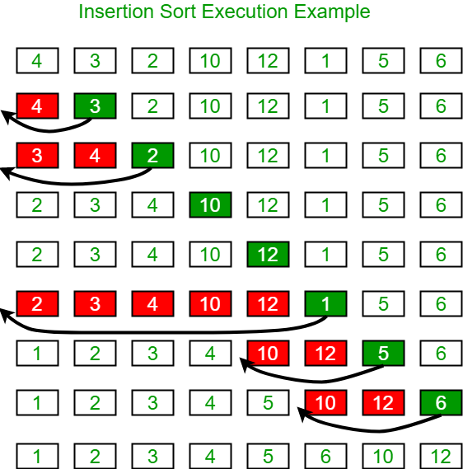

Slide 31
Another Insertion SortbExample: 12, 11, 13, 5, 6
Let us loop for i = 1 (second element of the array) to 5 (Size of input array)
i = 1. Since 11 is smaller than 12, move 12 and insert 11 before 12 11, 12, 13, 5, 6
i = 2. 13 will remain at its position as all elements in A[0..I-1] are smaller than 13 11, 12, 13, 5, 6
i = 3. 5 will move to the beginning and all other elements from 11 to 13 will move one position ahead of their current position. 5, 11, 12, 13, 6
i = 4. 6 will move to position after 5, and elements from 11 to 13 will move one position ahead of their current position. 5, 6, 11, 12, 13

